Slide 1



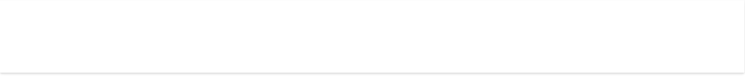





























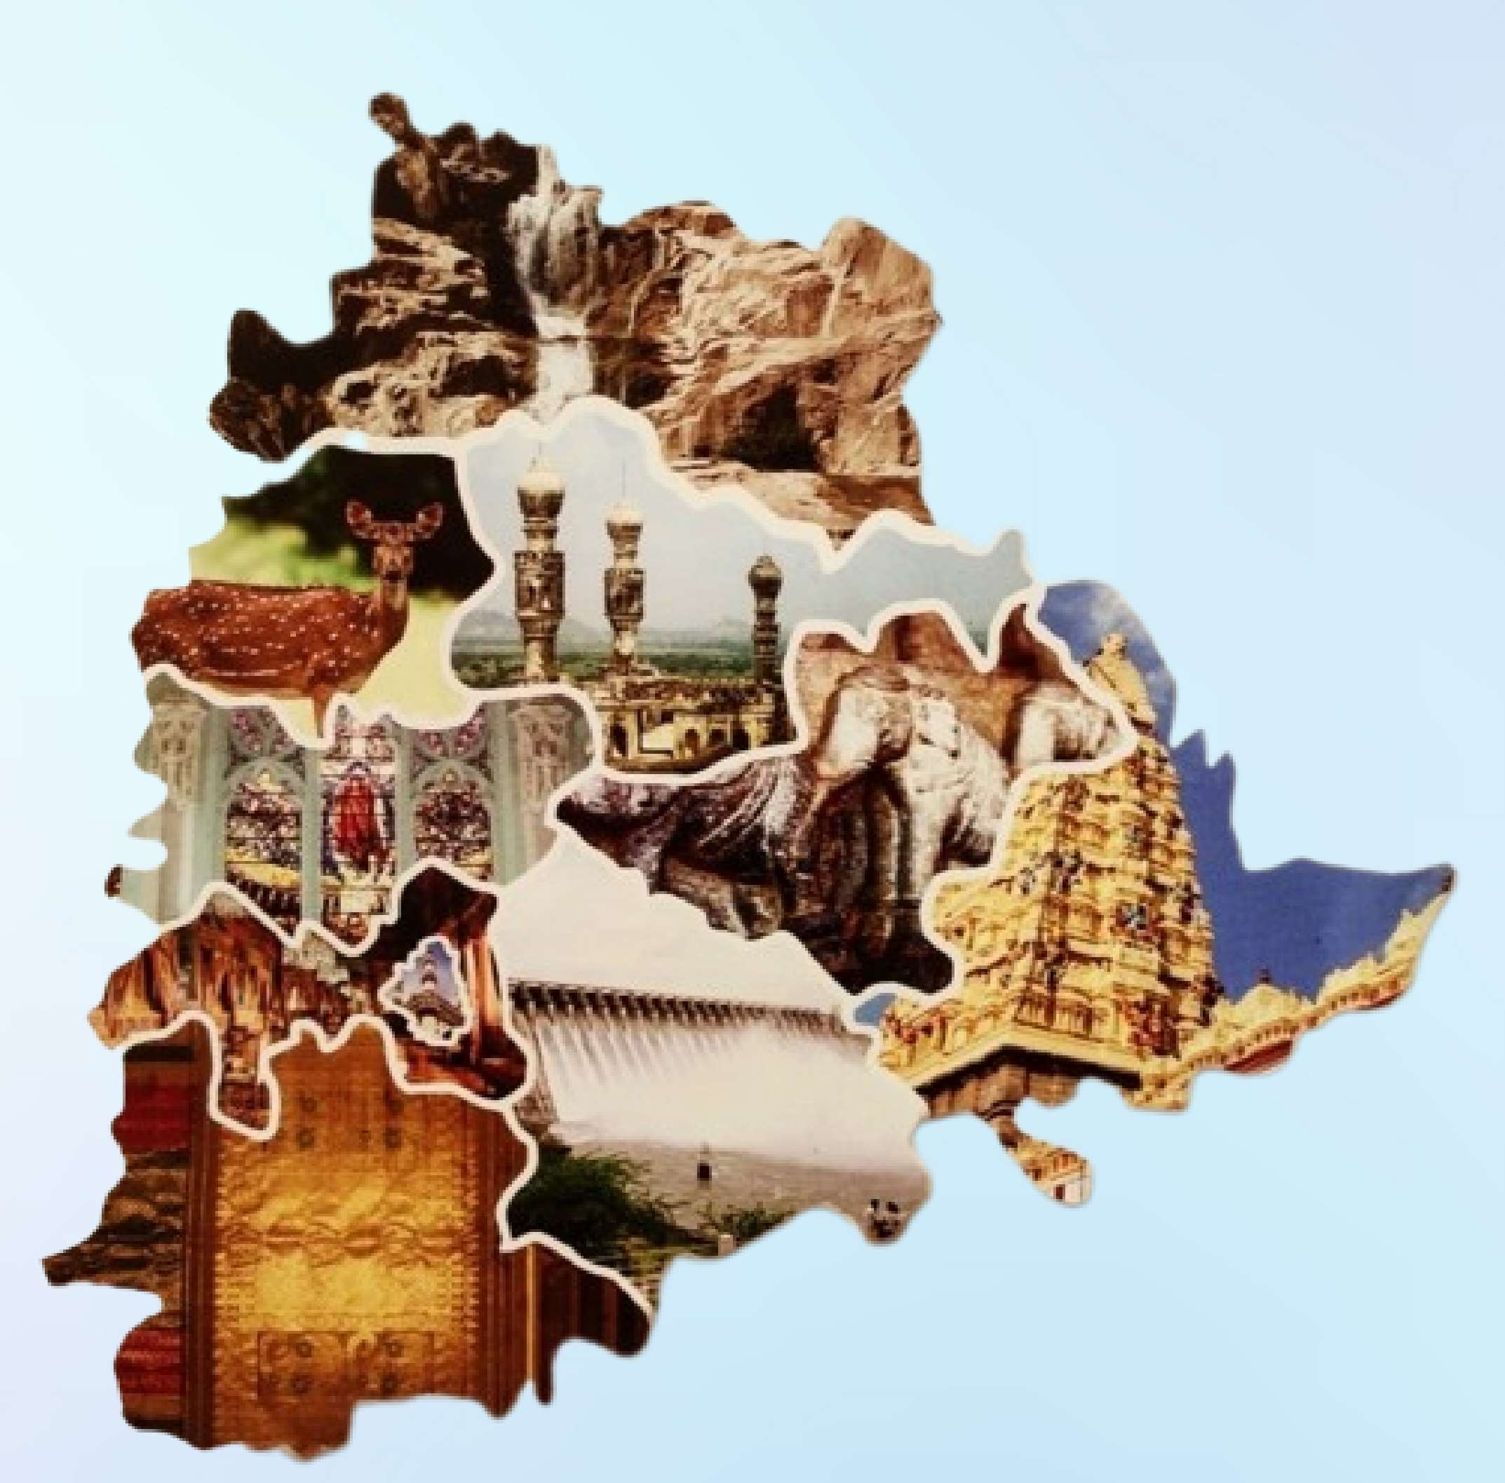


CREATED BY
AMRUTH SIVARAMAKRISHNAN

Slide 2
OBJECTIVES
Telangana is one of India’s leading states and has published its tourism data under its open data policy.
The Main objective is to find the patterns in the given data.
To do additional research, and give data-informed recommendations to the Telangana government.
To provide valuable insights which can be used to increase the revenue of Telangana Government by improving administrative operations.

Slide 3
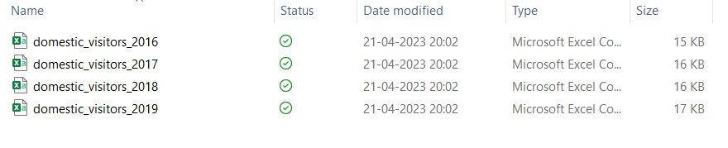
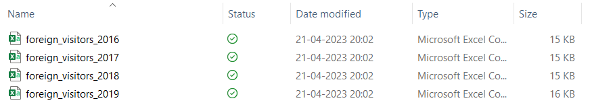
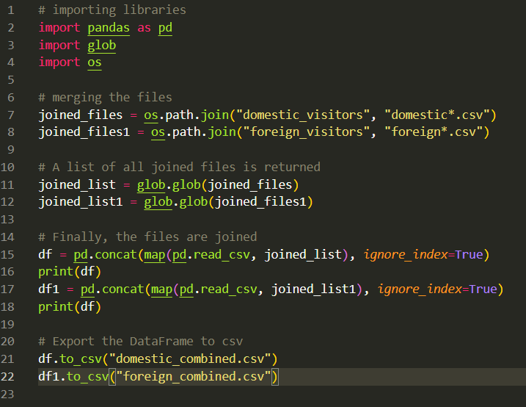

DATA, REQUIREMENTS AND TOOLS
Initial Dataset provided for the project
Domestic Visitors (2016 – 2019)
Foreign Visitors (2016 – 2019)
To Merge all individual CSV files in "domestic_visitors" and "foreign_visitors" folders using a data integration tool Pandas in python.

Slide 4
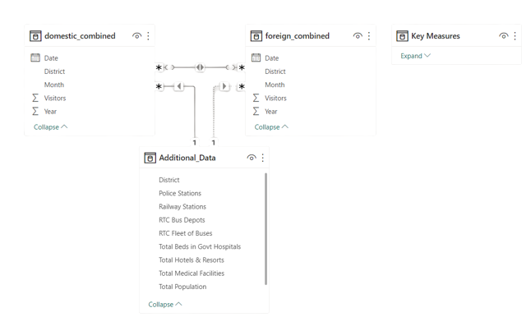

DATA, REQUIREMENTS AND TOOLS
Prepared from the given Dataset for this project and additional data from the Telangana Government’s open data website. Link: https://data.telangana.gov.in/
For Data Transform, Data Modelling & Data visualization

Slide 5
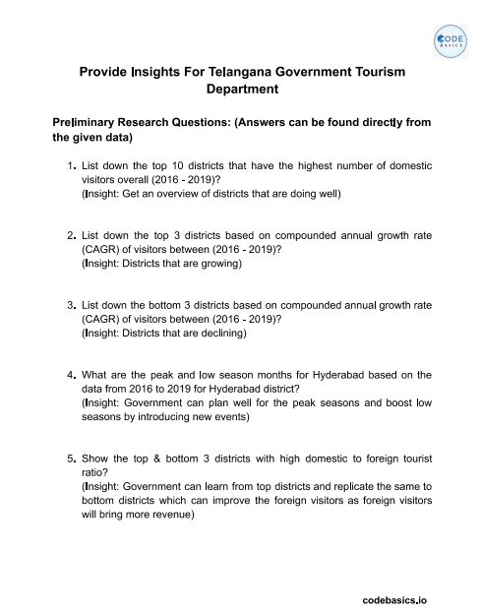
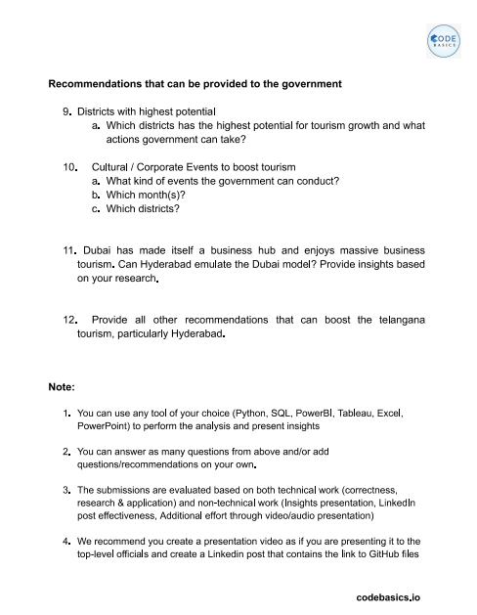
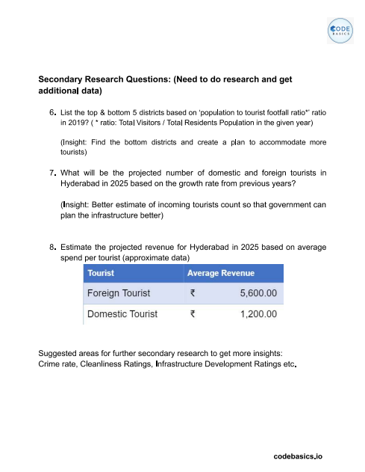
DATA, REQUIREMENTS AND TOOLS
For creating Dashboard and Insights

Slide 6


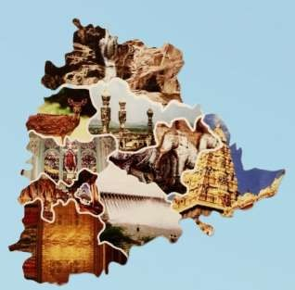







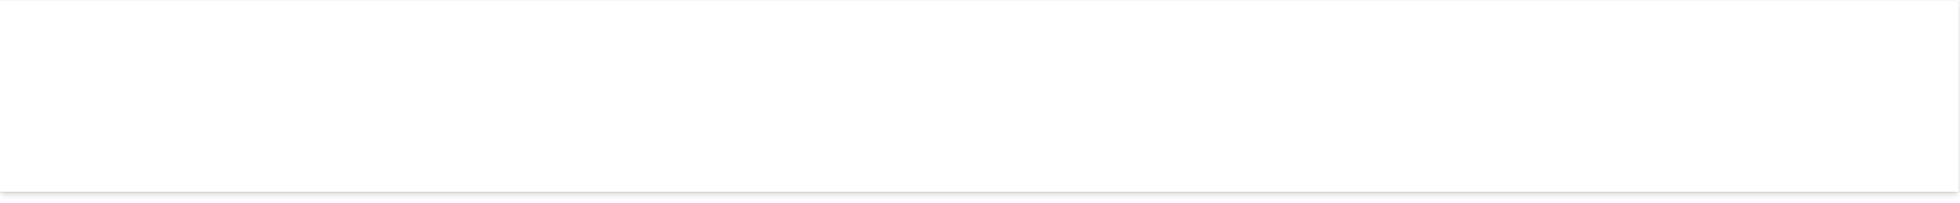
















































































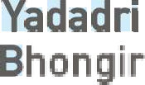
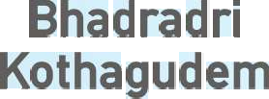



































Slide 7

































































































































Slide 8

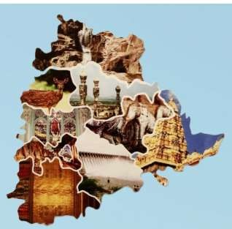














































































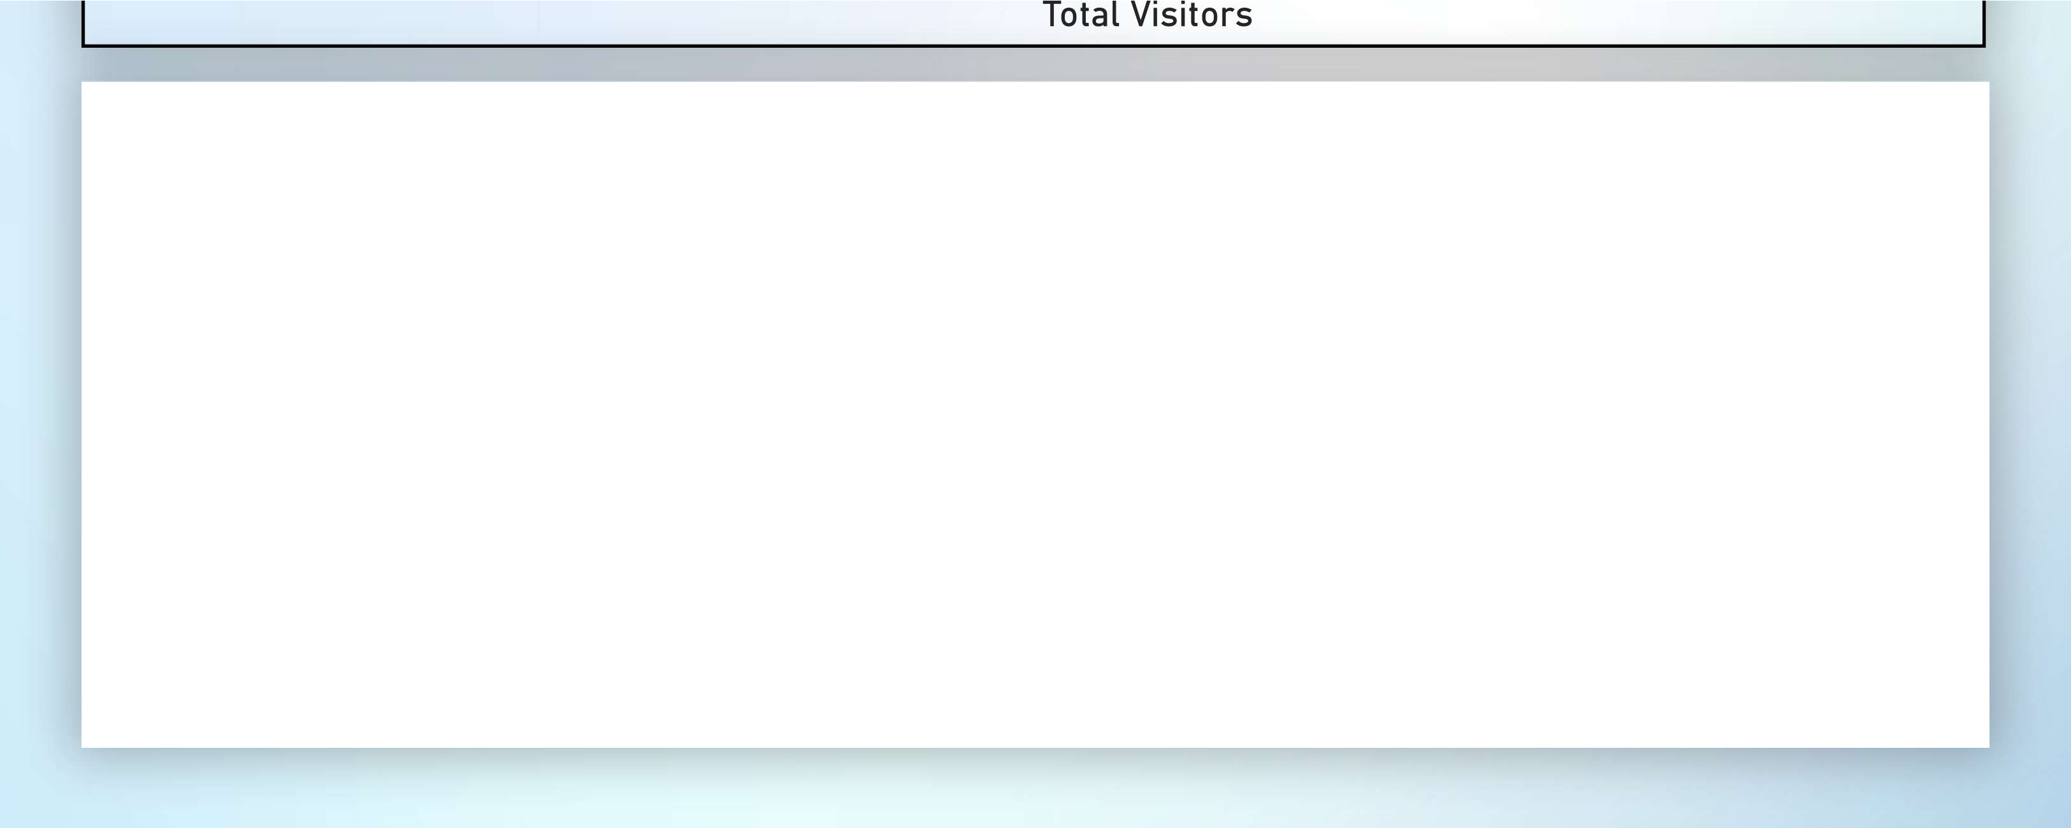






















































Slide 9


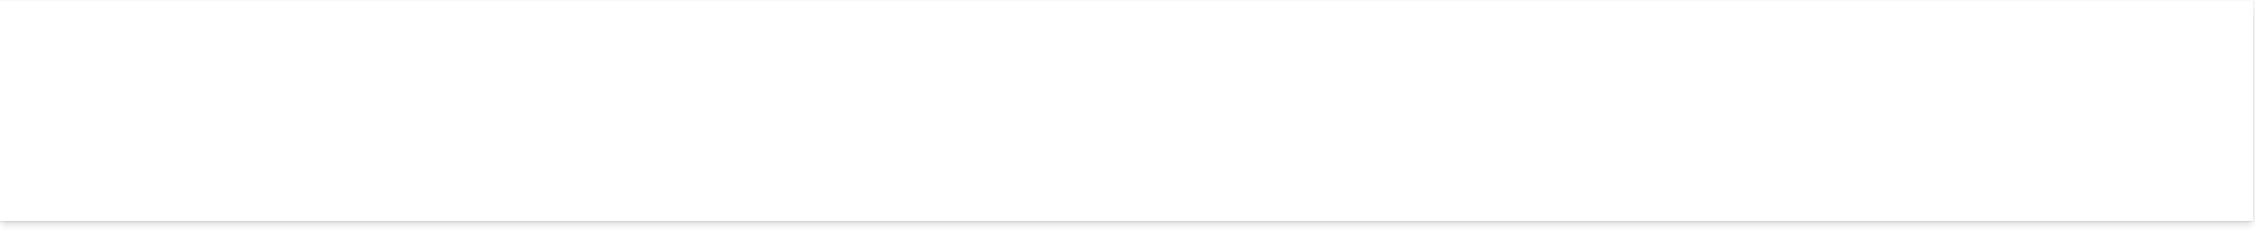








































































































































































































Slide 10




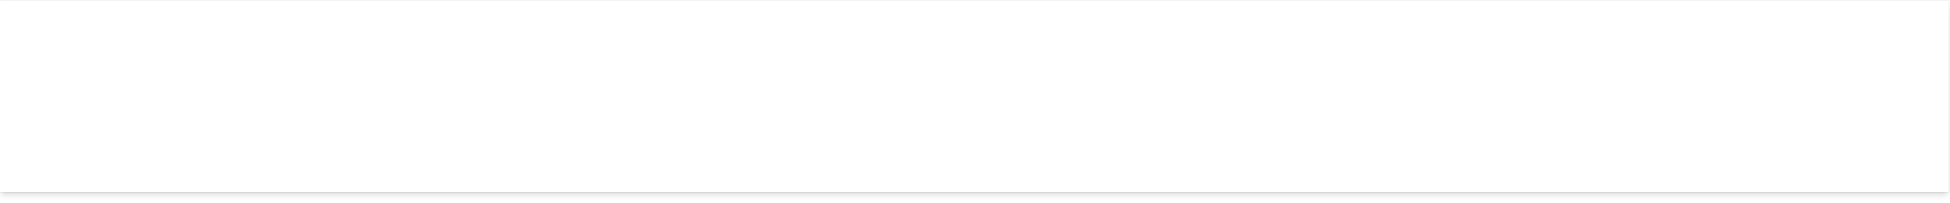
























































































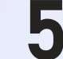
























































































Slide 11




































































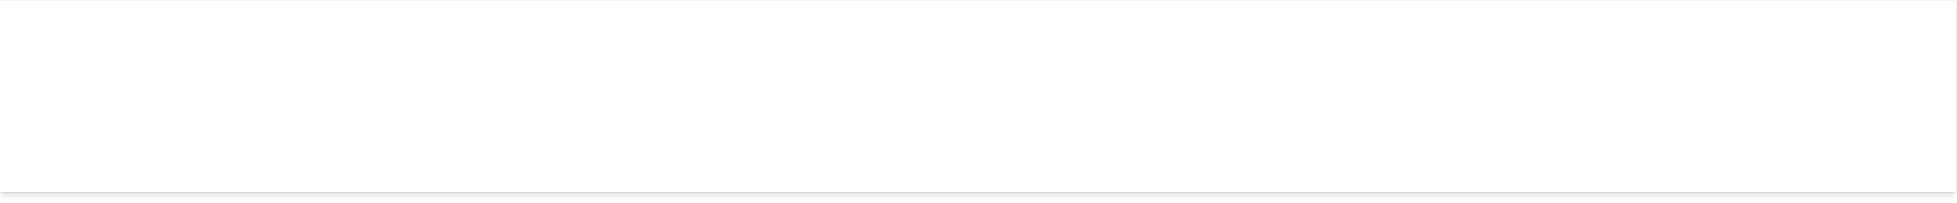



















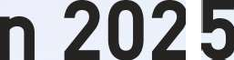

























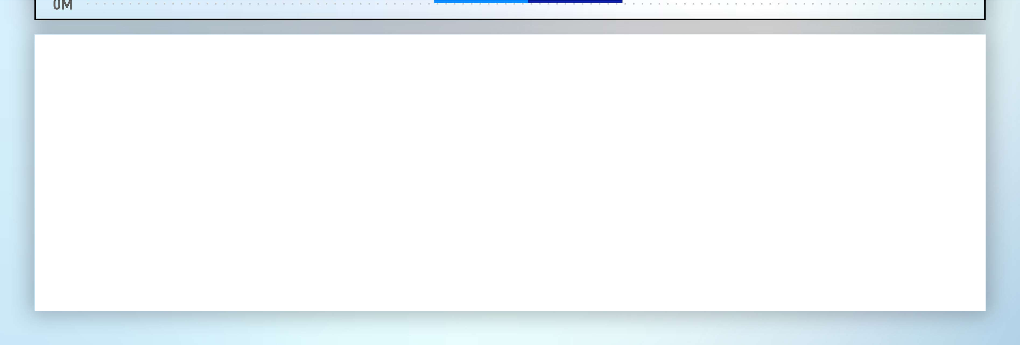



































































Slide 12


Slide 14
STRATEGIES FOR HYDERABAD TO BECOME A GLOBAL BUSINESS HUB AND TOURIST DESTINATION
DUBAI’S SUCCESS IN ESTABLISHING BUSINESS HUB:
Investment in world-class infrastructure
Tax-friendly policies
Focus on promoting tourism
Strategic location

Slide 15
STRATEGIES FOR HYDERABAD TO BECOME A GLOBAL BUSINESS HUB AND TOURIST DESTINATION

Slide 16
STRATEGIES FOR HYDERABAD TO BECOME A GLOBAL BUSINESS HUB AND TOURIST DESTINATION
DEVELOPMENT IDEAS FOR HYDERABAD:
Infrastructure development: airports, seaports, roads
Tax-friendly policies to attract businesses and investors
Promotion of tourism industry: rich history, cultural heritage, tourist attractions

Slide 17
STRATEGIES FOR HYDERABAD TO BECOME A GLOBAL BUSINESS HUB AND TOURIST DESTINATION
ADVANTAGES FOR HYDERABAD:
Increased business opportunities and investment
Boost to local economy and job creation
Increased foreign visitors
Improved quality of life for residents

Slide 18
EVENTS TO BOOST TOURISM IN TELANGANA
BUSINESS EXPO
RELIGIOUS FESTIVALS
ENTERTAINMENT EVENTS
CULTURAL EVENTS
SPORTS EVENTS

Slide 19
Hemanand Vadivel
aka Tony Sharma
Dhaval Patel
aka Peter Pandey
THANK YOU !

